Slide 1
Agenda
What is API
Best approaches when using this method
Examples

Slide 2
Application Program Interface
Set of programming instructions for accessing information or services from a Web-based software application.
Companies releases its API to the public so that other software developers can design products that can access its services.

Slide 3
Application Program Interface
Purchase at the grocery store with a debit/credit card
-API is used to verify your card so that you can make a purchase
Online travel service website for plane tickets.
Google maps on websites
NUMERICAL DATA SETS!!

Slide 4



Application Program Interface
Request
(https://censusapi.gov/data/<token>)
Cloud based server
API
Database
Client/Developer
server
Data
["NAME","POP","HISP","state"],…]

Slide 5
How can API help data analysts
Can periodically analyze data without time consuming process of preparing new data tables manually (copying new data in excel workbook, csv, etc..)
Reduce human errors when constructing these tables.
Focus more on analysis using up-to-date information

Slide 6
API Terminology
REST - REpresentational State Transfer. A REST API is one that adheres to certain principles that make interacting with them easier and less resource intensive.
Endpoint- the location that receives web requests
HTTP response: is the server's information as a result of the client's request. Payload : actual data pack that is sent with the GET method in HTTP
POST is used to send data to a server to create/update a resource.

Slide 7


API Architecture Types
More than one way to build a web API
REST, Simple object access protocol (SOAP),
Others

Slide 8

API Key
Used to identify the calling program, its developer, or its user to the Web site. API keys are used to track and control how the API is being used, for example to prevent malicious use or abuse of the API

Slide 9

What to look for when building a request
Documentation
Tutorial
Sign up for a key

Slide 10
Best approach using API requests
Know what your looking for
Ask for the API handbook/manual
Find the id number of the data series
Construct the URL request or other methods

Slide 11
Data Formats
JavaScript Object Notation (JSON)- text-based, human-readable format for representing simple data structures.
Extensible Markup Language (XML)- markup language that defines a set of rules for encoding documents in a format that is both human-readable and machine-readable.

Slide 12

API request status
$category
[1] "Success"
$reason
[1] "OK"
$message
[1] "Success: (200) OK"

Slide 13
Construct the URL API request
Example: Energy Information Administration (EIA) API
http://api.eia.gov/series/?series_id=ELEC.GEN.ALL-AK-99.A&api_key=<YOUR KEY>&out=json’

Slide 14
Construct the URL API request
Example: Energy Information Administration (EIA) API
http://api.eia.gov/series/?series_id=ELEC.GEN.ALL-AK-99.A&api_key=<YOUR KEY>&out=json’
http://api.eia.gov/series
&api_key= 'key code'
# identifies your unique individual identifier so the website can keep track of you and what you are downloading.
&out =‘json’ or’XML’
#what kind of format you want the requested data in
Predicates: words that come after the “&” or “?”

Slide 15
httr and jsonlite
httr::GET( )
GET method means retrieve whatever information (in the form of an entity) is identified by the Request-URI (uniform resource identifier).
jsonlite::fromJSON( )
used to convert JSON data into an R object (list)

Slide 16


Slide 17
R packages for API requests
blsAPI
WDI
rnoaa

Slide 18
Bureau of Labor Statistics API
R users- blsAPI package- one series
library(blsAPI)
library(rjson)
response<-blsAPI('CIU1010000000000A')
Series ID from website

Slide 19
World Bank API
R users- WDI package
library(WDI)
WDIsearch(string='gdp', field='name', cache=NULL) #search for the series
#pull data series
WDI(country=c("US","BR"), indicator="NY.GNS.ICTR.GN.ZS", start=1999, end=2000,
extra=TRUE, cache=NULL)

Slide 20
API for weather data
rnoaa package
library(rnoaa)
options(noaakey = “YOUR-KEY")
ncdc(datasetid = 'GHCND', stationid = 'GHCND:USW00014895', startdate = '2013-10-01',
enddate = '2013-12-01')

Slide 22


Bonus!!!

Slide 23

Lets pull Twitter data for analysis!
Create a free Twitter user account
Go to the Twitter Dev Site and Create a New Application
apps.twitter.com, sign in, and create a new application
(Wait to get approval email.)
3. Get your Twitter API keys

Slide 24
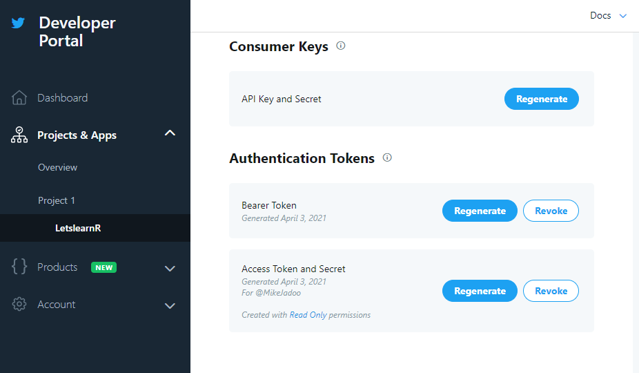
Get your Twitter API keys
Once approved, go to your developer app

Slide 25
Get your Twitter API keys
2. Get your keys

Slide 26
Get your Twitter API keys
2. Get your keys

Slide 27
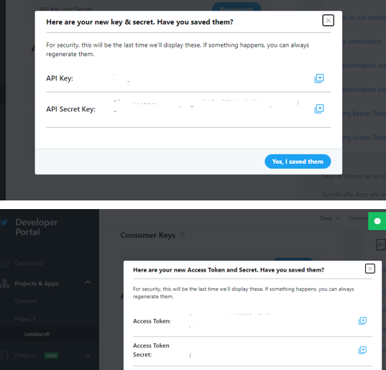
Get your Twitter API keys
2. Get your keys

Slide 28
TwitteR
twitteR is an R package which provides access to the Twitter API. Focus on API calls that are more useful for data analysis.
setup_twitter_oauth: Sets up the OAuth credentials for a twitteR session
searchTwitter: will issue a search of Twitter based on a supplied search string
twListToDF: A function to convert twitteR lists to data.frames

Slide 29


Slide 30
rtweet
rtweet- An implementation of calls designed to collect and organize Twitter data via Twitter's Application Program Interfaces (API)
create_token: Sets up the OAuth credentials for a twitteR session
search_tweets: Returns two data frames (tweets data and users data) using a provided search query

Slide 32
?

Slide 33



